Slide 1
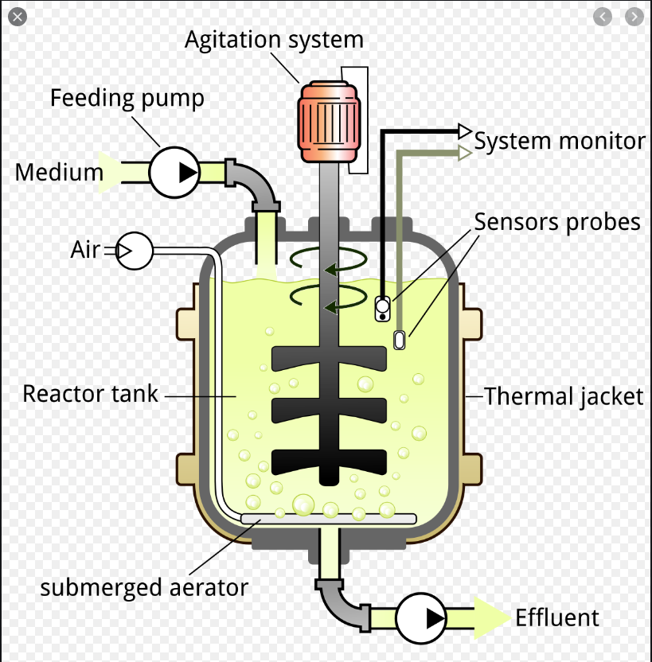
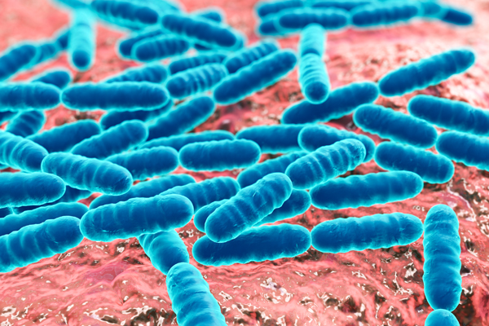
Lecture 8: Models of Microbial Growth
BSEN 5250/6250
Reading: Keen and Spain, Chapter 8

Slide 2
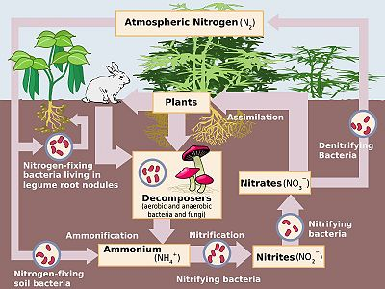
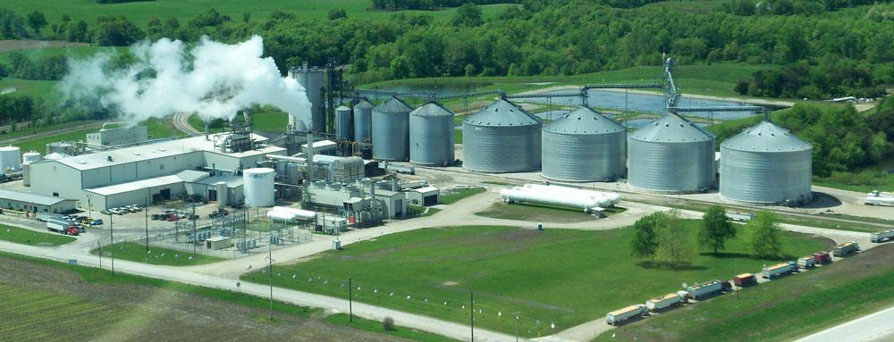
Microbial Populations
Fermentation processes
Corn starch to ethanol
Soil processes
Degradation of contaminants

Slide 3
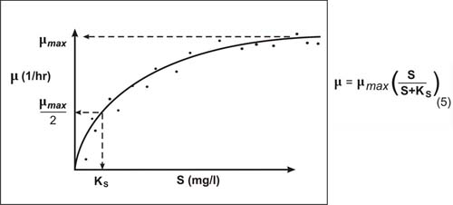
Monod Equation (Limited Substrate)
Growth Rate, 1/hr
Substrate, mg/l

Slide 4
Governing Equation – Monod Equation
B = Cell density, mg/l
µ = growth rate constant, 1/hr
ʮ_{M} = maximum growth rate when nutrients are not limiting, 1/hr
K_{s} = Half saturation constant (nutrient concentration that allows cells to growth at ½ the maximum rate, mg/l
|S| = Concentration of nutrient, mg/l

Slide 5

Euler Representation

Slide 6
Incorporating Organism Death
B = Cell density, mg/l
µ = growth rate constant, 1/hr
μ_{M} = maximum growth rate when nutrients are not limiting, 1/hr
K_{s} = Half saturation constant (nutrient concentration that allows cells to growth at ½ the maximum rate, mg/l
|S| = Concentration of nutrient, mg/l
R = rate constant representing loss of mass due to death and respiration, 1/hr

Slide 7
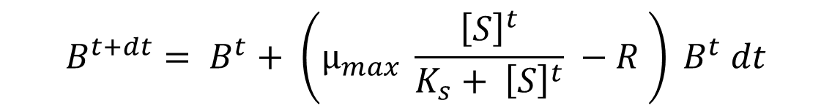
Euler Representation
$$B^{t+dt}= B^{t}+ \left(μ_{max} \frac{{\left[S\right]}^{t}}{K_{s}+ {\left[S\right]}^{t}} −R \right) B^{t} dt$$

Slide 8
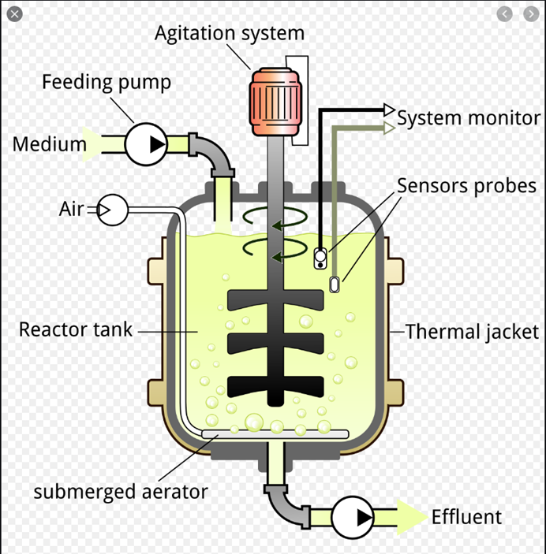
Batch Cultures
Nutrients are loaded into a tank, microbes are added, and when the nutrients are depleted, batch is completed.
Examples:
Drug production
Chemical production
Waste treatment plant
Fermentation processes

Slide 9
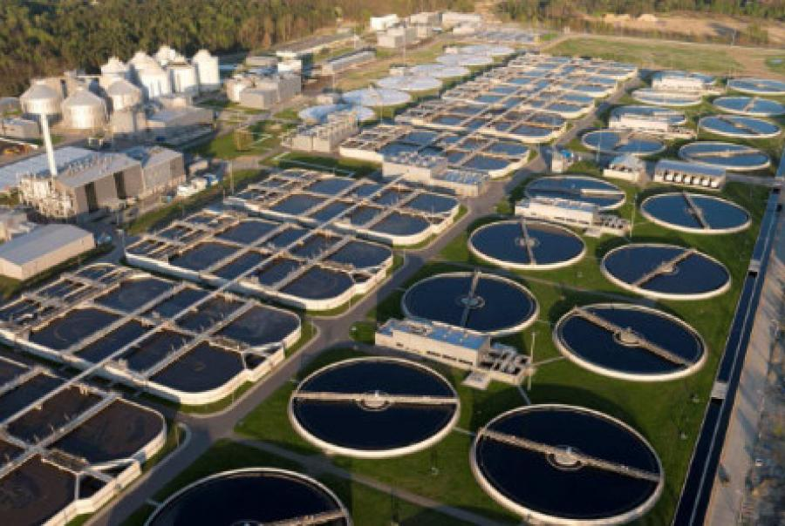
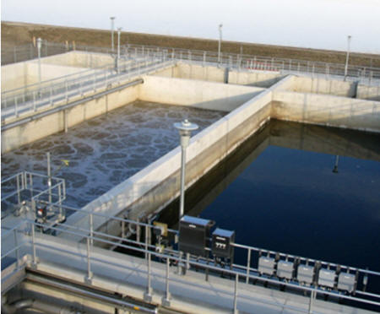
Batch Cultures – Waste Treatment Plant

Slide 10
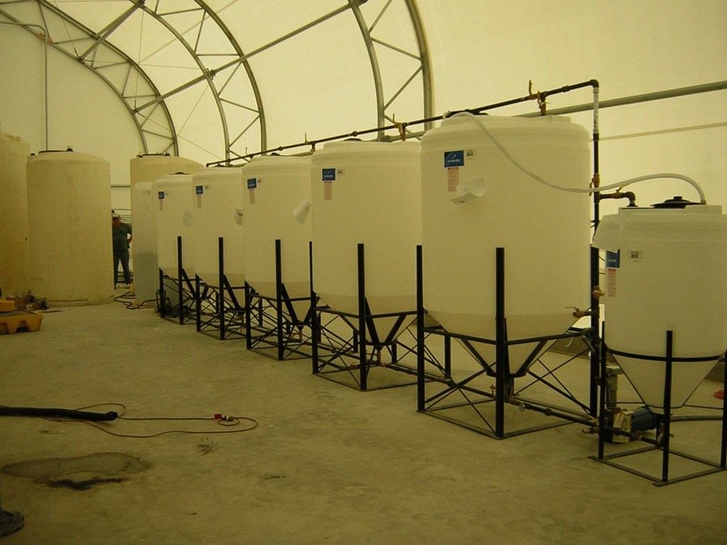
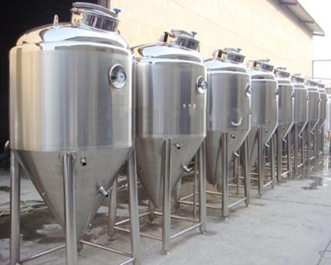
Batch Cultures
Cellulosic Ethanol Pilot Plant
Wine Batch Reactors

Slide 11
Batch Cultures
Microbial growth may follow a monod or logistic growth until nutrients are limited.
Nutrients are transferred from solution into the microbes
When microbes die, they release nutrients back into solution, promoting new growth
Process may continue perpetually

Slide 12
Batch Cultures
Where |S|_{Total} = total nutrients in the microbes and solution
|S| = nutrients in the solution
a = proportion of nutrient biomass concentration in microbial biomass

Slide 13

Example 8.1
Bacteria growing with limiting nutrient in a batch reactor
R = 0.03 /hr
a = 0.03
μ_{M} = 0.3/hr
[S]_{total} = 100 mg/l
K_{s} = 25 mg/l
B^{t=0} = 1 mg/l
Solve using time step of 0.2 hr

Slide 14
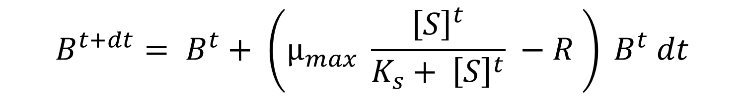
Euler Representation
$$B^{t+dt}= B^{t}+ \left(μ_{max} \frac{{\left[S\right]}^{t}}{K_{s}+ {\left[S\right]}^{t}} −R \right) B^{t} dt$$
See spreadsheet example 8-1

Slide 15
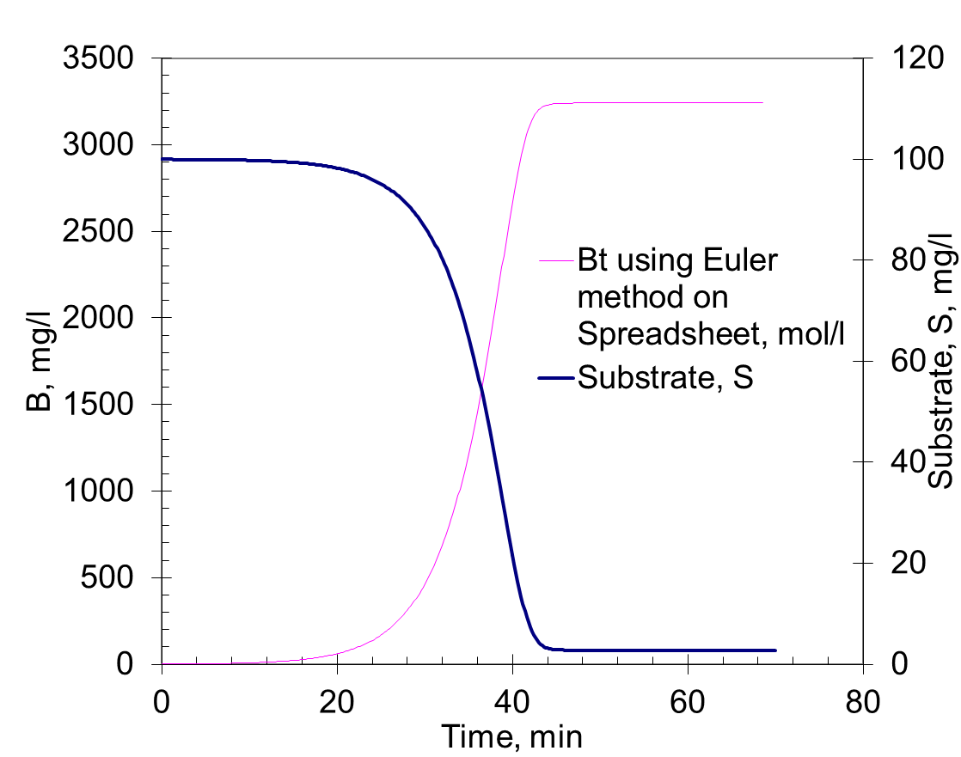

Slide 16
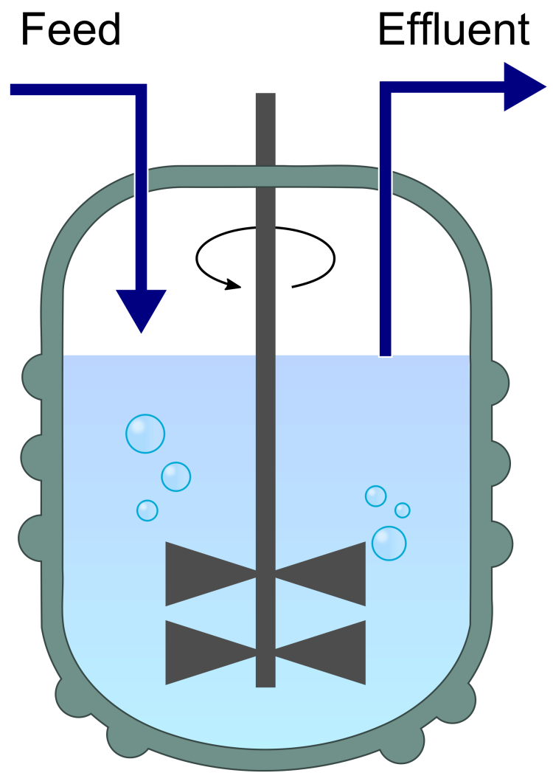
Continuous Culture in Chemostat
B = cell biomass, mg/l
µ = growth rate, 1/hr
D = dilution factor (flow/volume), 1/hr

Slide 17
Governing Equation
D = dilution factor
a = fraction of nutrients incorporated into biomass
µ = growth rate constant, 1/hr
D[S] – nutrients flowing out
D[S_{in} ] nutrient input
[S]
µBa – uptake of nutrients by cell

Slide 18
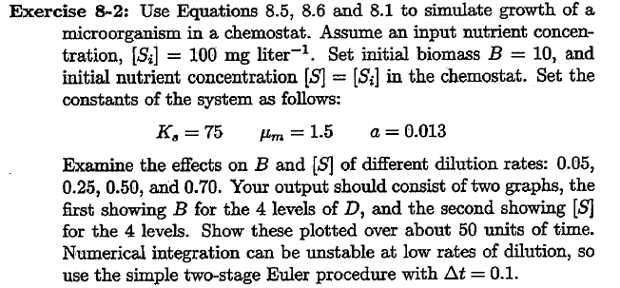
Example 8.2

Slide 19
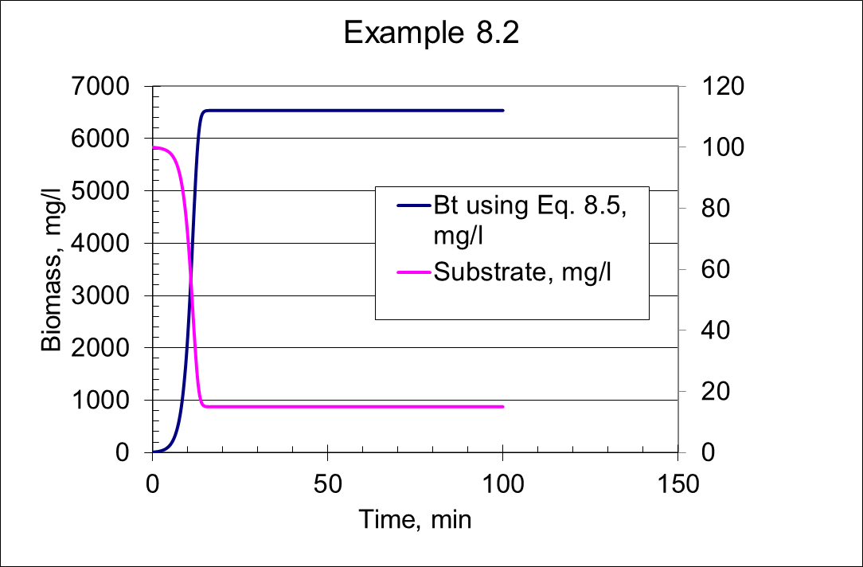

Slide 20
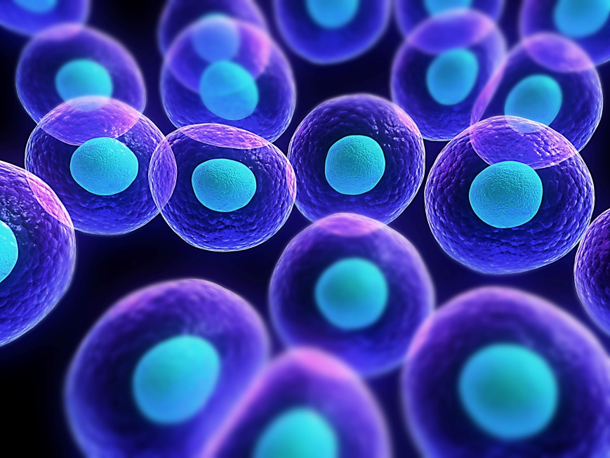
Multiple Limiting Nutrients
Cells
Silicon [S]
Nitrogen [N]
Phosphorus [P]

Slide 21
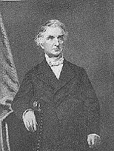
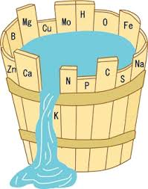

Liebig’s Law of the Minimum
Growth is controlled by the most limiting nutrient
Yield is proportional to the amount of the most limiting nutrient

Slide 22
Multiple Limiting Nutrients
Factors range from 0-1.0
[S] = Silicon, mg/L
[N] = Nitrogen, mg/L
[P] = Phosphorus, mg/L
µ_{m} = Max growth rate, 1/hr
K_{S} , K_{n} and K_{P} = half saturation constants for S, N and P

Slide 23
Multiple Limiting Nutrients
Nutrient in solution
Nutrients incorporated into Biomass
% by weight

Slide 24
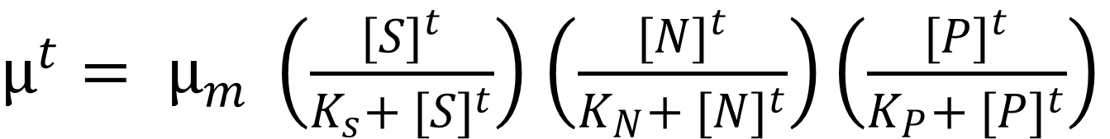
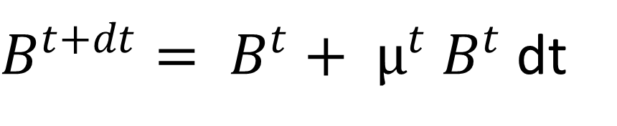
Euler Integration
$B^{t+dt}= B^{t}+ µ^{t} B^{t}$ dt
$µ^{t}= µ_{m} \left(\frac{{[S]}^{t}}{K_{s}+ {[S]}^{t}}\right)$ $\left(\frac{{[N]}^{t}}{K_{N}+ {[N]}^{t}}\right)\left(\frac{{[P]}^{t}}{K_{P}+ {[P]}^{t}}\right)$
State Variable is B
Rate variable is dependent on concentration of S, N and P in solution

Slide 25
Solving for Nutrient Concentration in Batch Solution
Rearrange equations to solve for concentration in medium
[S]^{t+dt} = [S]_{total} – a_{s}B^{t+dt}
[N]^{t+dt} = [N]_{total} – a_{N}B^{t+dt}
[P]^{t+dt} = [P]_{total} – a_{P}B^{t+dt}

Slide 26
Example 8-4
Coefficients and Initial Conditions
 | S | N | P
Variable | Value | Value | Value | Units
R | 0.005 | 0.005 | 0.005 | 1/hr
a | 0.15 | 0.1 | 0.005
M_{m} | 0.12 | 0.12 | 0.12 | 1/hr
S | 10 | 1 | 0.1 | mg/L
k_{s} | 0.1 | 0.15 | 0.04 | mg/L
B | 0.1 | 0.1 | 0.1 | mg/L
Timestep | 1 | 1 | 1 | minute
Final Time | 120 | 120 | 120 | minute

Slide 27
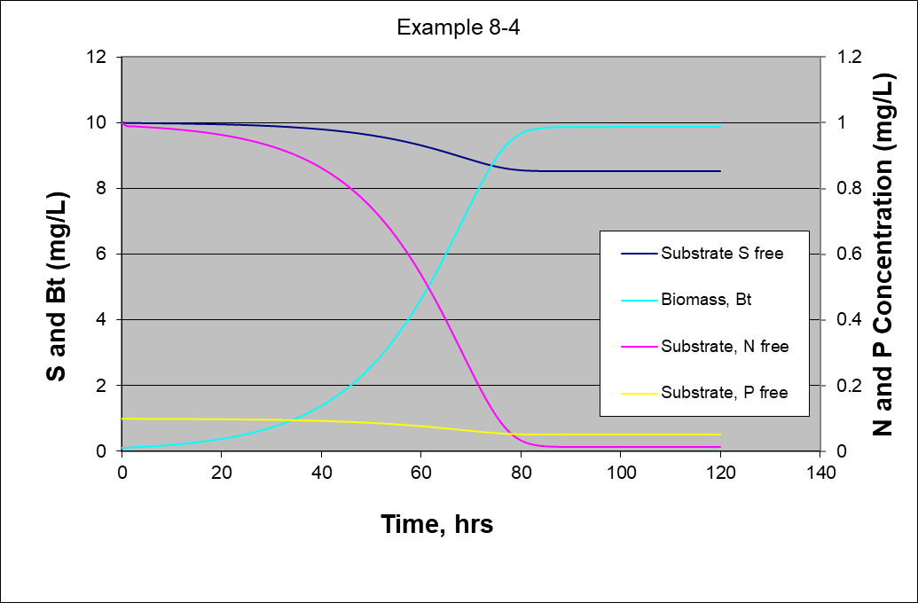
Solution to Example 8-4

Slide 28
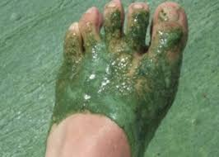
Competition for Nutrients
N dissolved in Water
N Dissolved in Water
N dissolved in Water
N dissolved in Water
N dissolved in Water
N Gas Bubbles from Atmosphere Dissolved in Water
Blue-Green Algae
Biomass
Green Algae
Biomass
N dissolved in Water
P Dissolved in Water

Slide 29
Competition for Nutrients
µ_{G} = growth rate of green algae, 1/time
µ_{mG} = growth rate of green algae at saturation with N and P, 1/time
[P] = concentration of available phosphorus, mg/L
[N] is concentration of available nitrogen, mg/L
K_{pG} = half saturation constant for phosphorus and green algae, mg/L
K_{nG} = half saturation constant for nitrogen and green algae, mg/L

Slide 30
Competition for Nutrients
µ_{B} = growth rate of blue-green algae, 1/time
µ_{mB} = growth rate of blue-green algae at saturation with N and P, 1/time
[P] = concentration of available phosphorus, mg/L
[N] is concentration of available nitrogen, mg/L
[n] = concentration of dissolved molecular nitrogen gas, mg/L
K_{pB} = half saturation constant for phosphorus and blue-green algae, mg/L
K_{NB} = half saturation constant for nitrogen and blue-green algae, mg/L

Slide 31
Competition for Nutrients
Green Algae Growth
Blue-Green Algae Growth
G and B are biomass concentrations of green and blue-green algae, mg/L
µ_{G} and µ_{B} are growth rates for green and blue-green algae, 1/time
R_{G} and R_{B} are mortality and respiration rates for green and blue-green algae, 1/time

Slide 32
Competition for Nutrients
When algae die, they release nutrients back to the water
Phosphorus in
Blue-green algae
Phosphorus in Green algae
a_{pG} and a_{pB} is phosphorus content of Green and Blue-green algae

Slide 33
Competition for Nutrients
Nitrogen in
Blue-green algae
Nitrogen in Green algae
a_{nG} and a_{nB} is nitrogen content of Green and Blue-green algae

Slide 34
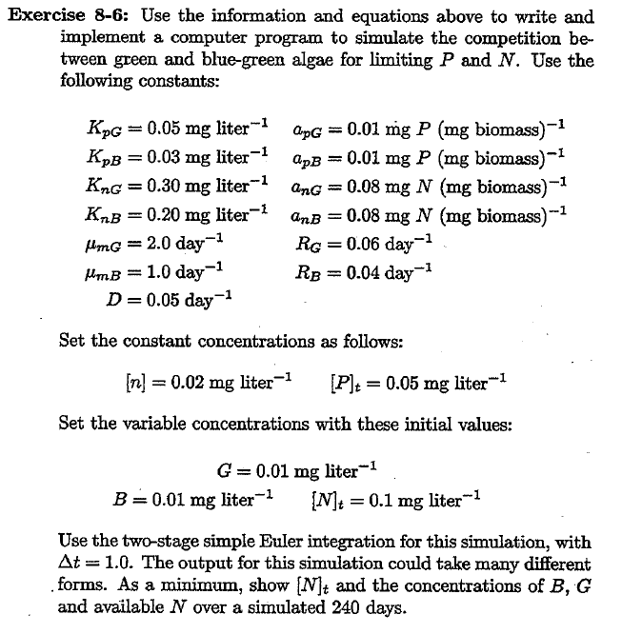
Example 8-6

Slide 35
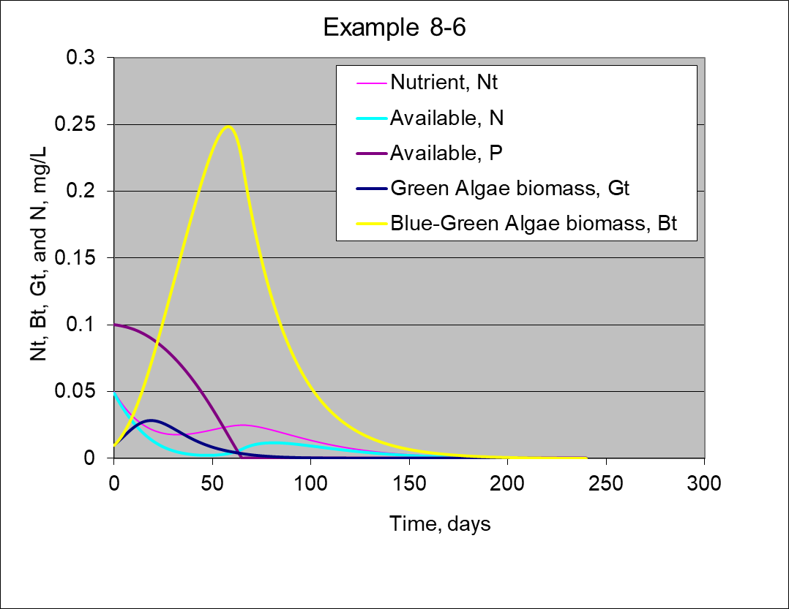
Solution to Example 8-6

